Slide 1


Plant
Master Drain
Study
October 15, 2025

Slide 2
Agenda
Introductions
Procurement Schedule
Procurement Requirements
Project Scope of Work
Questions and Answers

Slide 3
ALCOSAN Project Team
Procurement: Tawanda Stamps, Contract Administrator
      Ash Eberle, Contract Administration Specialist
Project Managers: Dustin Copenhaver Project Engineer and PM
        Kim Kennedy, PE Director of Engineering & Construction
        Jeff Argyros, PE Manager of Capital Projects

Slide 4
Procurement Schedule
November 12 at 2:00 PM – Statement of Qualifications due
  Electronic copy sent to Procurement@alcosan.org
December 2025 – RFP issued to shortlist*
February 2026 – Proposals due*
TBD 2026 – Interviews*
March 2026 – Contract Award*
April 2026 – Notice to Proceed*
* - tentative dates

Slide 5
Submittal
Follow the Directions
SF 330 Forms – Part I only
  Parts A-C – Identify the team
  Part D – detailed organizational chart with names/roles
  Case Histories (Part F) – make sure proposed staff worked on them
  Project-Based Resumes (Part E)
  Matrix of Case Histories v. Proposed Staff (Part G)
  Part H – two pages to discuss why your team should be selected.

Slide 6
MWDBE/SDVOSB
MBE/WBE/SDVOSB Participation – include certification
10-25% MWBE – total contract value
3% SDVOSB – total contract value
Relevant roles on the contract, part of the evaluation
ALCOSAN only accepts third-party certifications
  SBA – SDVOSB
  PAUCP
  EMSDC
  WBENC

Slide 7
Additional Information
Cover Letter – 2 Pages – executive summary
Identify RTK Law-exempt pages of your submittal
Conflict of Interest forms for each team member
How are you going to do this work?
Avoid “Marketing” text

Slide 8
Selection Criteria
Firm’s history and resource capability to perform required services
Evaluation of assigned personnel
Related experience
Ability to meet schedule and project budget
Familiarity with local area geography and facilities
Local office within Allegheny County
Ability to relate to project requirements
MBE/WBE/SDV Participation

Slide 9
Project Scope
Consultant is to assist with reviewing existing data via 3D MicroStation model, existing drawings, latest construction modifications and compare to existing conditions
Existing conditions to be surveyed for location (in state plane and local plant coordinates) and condition (NASSCO)
  Manhole, catch basin and pipe inspections
  Inverts and materials of construction
Assess for hydrologic and hydraulic capacities
Identify issues and provide high level repair suggestions
Provide GIS model containing all of the findings

Slide 10
Challenges
Busy, but manageable site – 24/7 treatment plant with road closures and contractor activities
Cleaning of pipes is done on an as needed basis
Combined system – no rain might not equate to empty pipe
  Storm, Sanitary, Scrubber (high and low pH), Process (centrifuge centrate, tank drains etc.)
Coordinating low flow/no flow times for inspections based on operations
Some bypass pumping will be required

Slide 11
Known Issues
Process pipes scaled over
Collapsed drains
Clogged drains
Lack of slope
Questionable flow patterns
Bottoms of pipes missing
Combined system causing capacity issues during wet weather

Slide 12
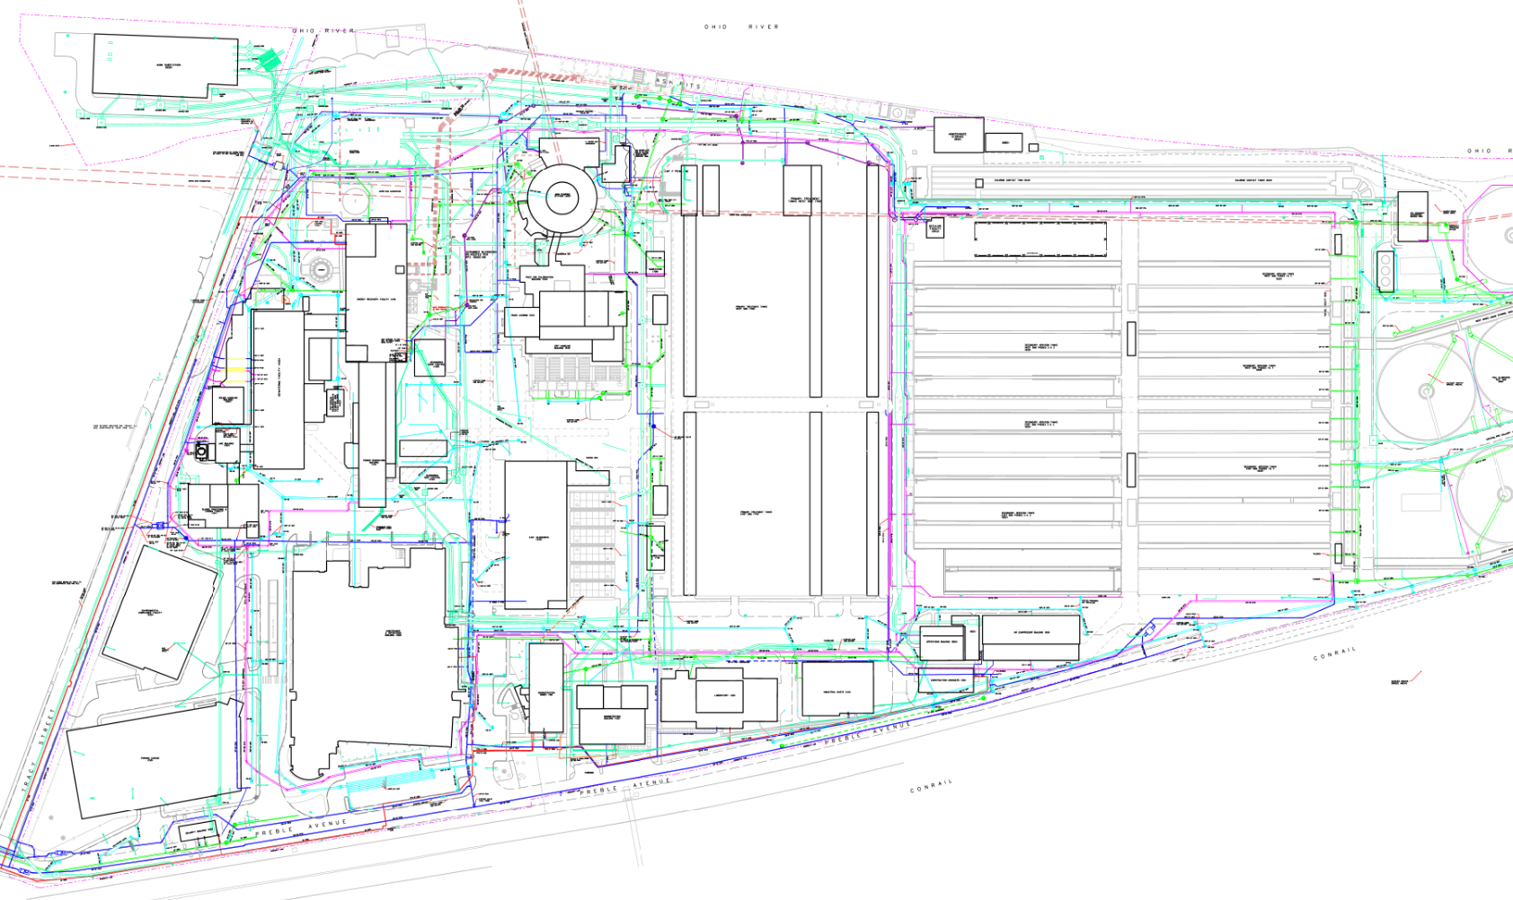

Slide 13
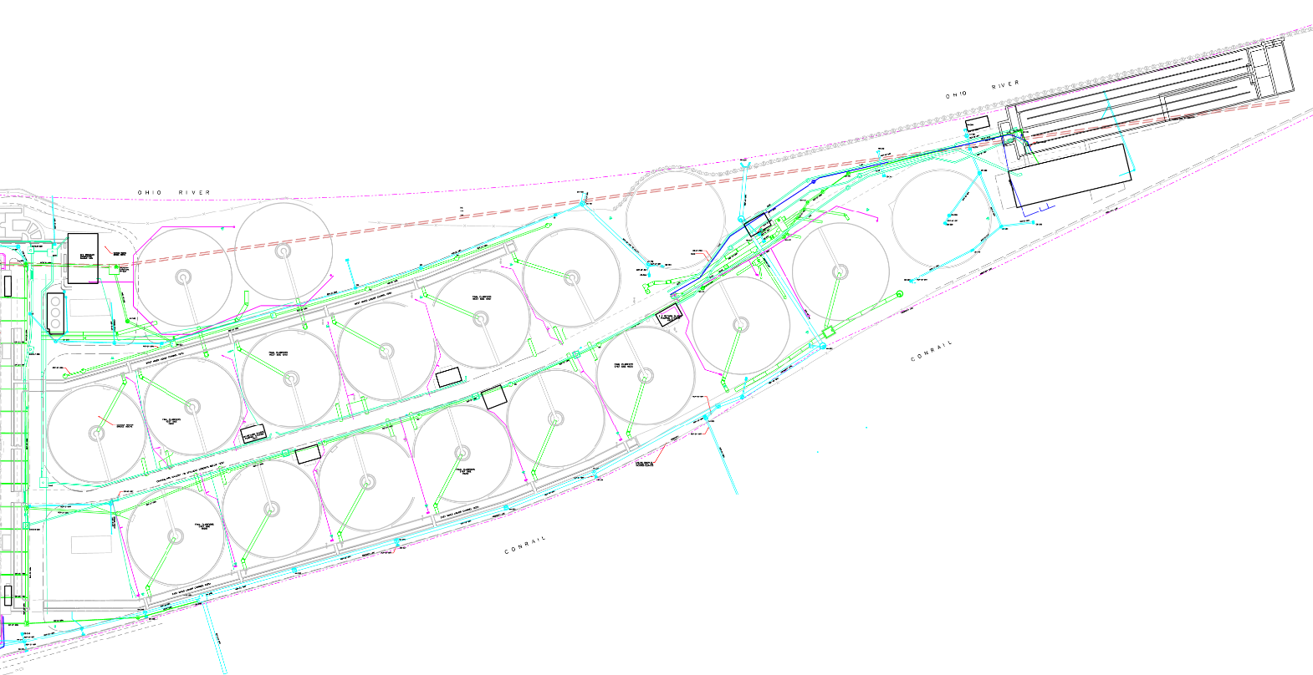

Slide 14
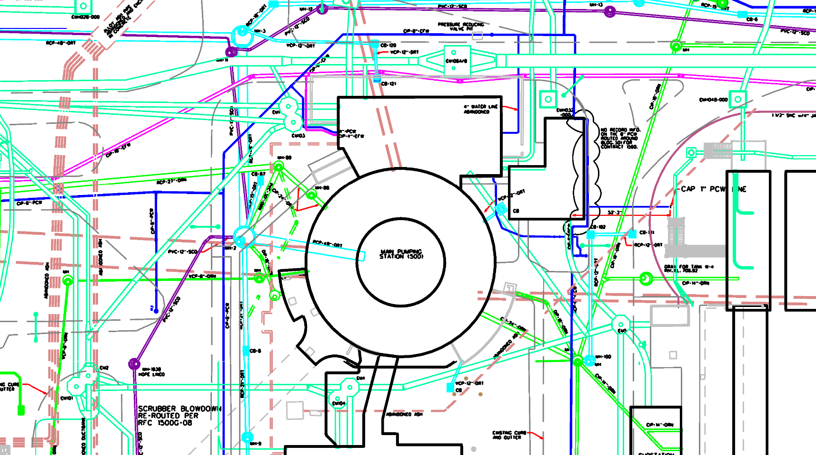

Slide 15
Questions /
Comments?
Contact:
Tawanda Stamps
Contract Administrator
(412) 732-8020
Procurement@alcosan.org

