Slide 1


Underground Utility
Locating Services
Informational Meeting
October 1, 2026

Slide 2
Agenda
Procurement Requirements
MWBE/SDVOSB Program
Scope of Work
Questions and Answers

Slide 3
ALCOSAN Project Team
Procurement: Tawanda Stamps, Director of Procurement
      Ash Eberle, Contract Administration Specialist
Project Manager: Darnetta Craig, PE Project Engineer III and PM
          Nate Carll, PE Manager of Interceptor Systems

Slide 4
Communications
All communications must be through email at procurement@alcosan.org
Hold your questions until the end.
Q&A will be issued in an addendum.

Slide 5
Procurement Schedule
Qualifications due electronically October 21, 2026 by 2:00pm EST
Firms shortlisted: November 2026 Board Meeting*
RFP Release: Early December 2026*
Proposals Due: December 2026*
Contract Award: January 2026*
Negotiate and Award Fee: February 2026*
Issue Notice to Proceed: July 2026*
*Tentative dates

Slide 6
Submittal
Letter of Commitment – 2 pages max. – Executive Summary
Provide 5 case histories using SF 330
Resumes limited to 2 pages per resume
Organizational chart – clear roles and responsibilities
Do not include SF 330, Section H in the Submittal.

Slide 7
MWDBE/SDVOSB
Part of the evaluation:
MBE/WBE/SDVOSB – include certification
10-25% MWBE – total contract value
3% SDVOSB – total contract value
Relevant roles on the contract
ALCOSAN only accepts third-party certifications; no self-certifications
  SBA – SDVOSB
  PAUCP
  EMSDC
  WBENC

Slide 8
Additional Information
Identify RTK Law-exempt pages of your submittal
Conflict of Interest forms for each team member
Avoid “Marketing” material

Slide 9
Selection Criteria
Firm’s history and resource capability to perform required services
Evaluation of assigned personnel
Related experience
Ability to meet schedule and project budget
Familiarity with local area geography and facilities
Local office (10-county region: Allegheny, Armstrong, Beaver, Butler, Fayette, Greene, Indiana, Lawrence, Washington, Westmoreland)
Ability to relate to project requirements
MBE/WBE/SDV Participation

Slide 10
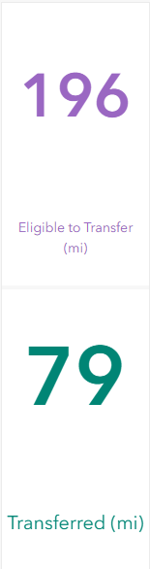
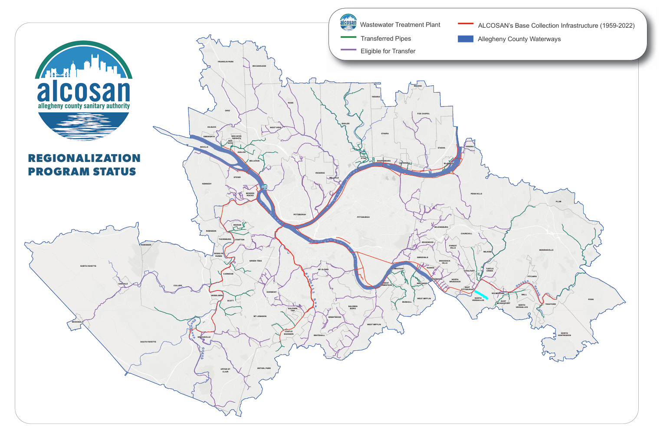
Scope of Work

Slide 11
Scope of Work
2026 Monthly Ticket History - Average| Lowest | Highest
 | MONTHLY
Item | Average | Low | High
Office Screen | 383 | 315 | 438
Field Screen (first 1,000ft) | 77 | 48 | 108
Utility Location Field screen, Additional Locate | 0 | 0 | 0
Emergency Regular Hours | 42 | 12 | 28
Emergency After Hours | 30 | 9 | 34
Total Tickets (Monthly) | 533 | 384 | 607

Slide 12
Scope of Work
Provide sufficient staff, equipment, and materials to perform work required to respond to utility location requests
Manage utility tickets in Utilisphere or compatible software program
Locate ALCOSAN's facilities as required by the Pennsylvania Act 50, the "Underground Utility Line Protection Act."

Slide 13
Scope of Work
Manage AlCOSAN's location maps according to ALCOSAN Policy
Notify the excavator of the presence of identifiable, but unlocatable facilities with disclaimer
Provide photos for all field marked utilities for each applicable ticket
Maintain records of all requests for three(3) years

Slide 14
Questions /
Comments?
Contact:
Tawanda Stamps
Director of Procurement
Procurement@alcosan.org

